Slide 1
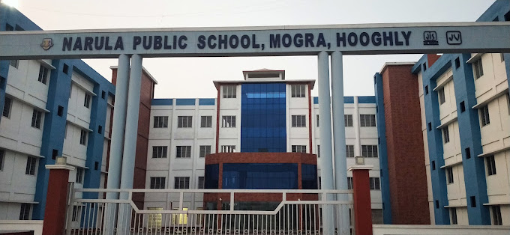
NARULA PUBLIC SCHOOL, MOGRA AIMS TO BE THE CENTER OF EXCELLENCE IN EDUCATION USING STATE-OF-THE-ART TECHNOLOGY, WHERE THE SEEDS OF THE ALL-ROUND DEVELOPMENT OF THE CHILDREN ARE SOWN AT AN EARLY AGE. IT IS OUR IMMENSE PLEASURE AND PRIDE TO PRESENT TO YOU A REPORT OF OUR ACTIVITIES AND ACHIEVEMENTS FOR THE PAST ONE YEAR (2023-24)

Slide 2


Narula Public School- A K-12 CBSE Affiliated School
NARULA PUBLIC SCHOOL is a k-12 CBSE affiliated school . The school got its affiliation on 11th May,2023. It was a remarkable day for all of us The imposing infrastructure of Narula Public School, Mogra, a co-educational, English medium initiative of the JIS Group imparting value based school education comparable to the best international pedagogical standards, is all prime to opened from April, 2019. Nestled in the lap of nature, miles away from the city din, amidst the lush green heartland of Hooghly district in West Bengal, Narula Public School, Mogra aspires to integrate scholastic & co-scholastic dimensions of pedagogy in accordance with the CBSE outline with an objective of providing joyful learning experiences to the students, thereby ensuring their holistic development.
AFFILIATION OF NPS

Slide 3

Vision
To, “Enrich, Empower, Enlighten” our children through discovery, innovation, exposure & interaction for building effective human talents in context of national & global needs.
Mission
Through the integration of differentiated instruction, quality teaching, collaboration, inclusive learning environment & suitable technological resources, Narula Public School endeavors to provide unmatched experiential education for improving student learning outcomes, ensuring physical, emotional, social & intellectual well-being of the students.
The entrepreneurial zeal and vision of the founder & Chairman of JIS Group, late Sardar Jodh Singh resulted in the group consolidating considerable stake in dairy business, telecommunication, transportation, infrastructure, logistics, education & healthcare. His noble desire to serve the society through education led to the formation of the JIS Group Educational Initiatives, which presently is the largest education service provider in Eastern India, having under its aegis 30 Institutions of higher education, catering to nearly 37,000 students, enrolled in 140 diverse academic programmes! Due to the opening of Narula Public School & the Vertical integration of courses from Nursery to PhD under one roof, stakeholders & parents will get a unique opportunity to plan the education of their wards effectively.
Mr. Taranjit Singh, the Managing Director of JIS Group Educational Initiatives relevantly observes, “The Group's Educational Initiatives are committed to creating an academic ground for social, cultural, scientific, economic and technological development nationally and globally and aspire for excellence that will bring the holistic development of our society and mankind.

Slide 4
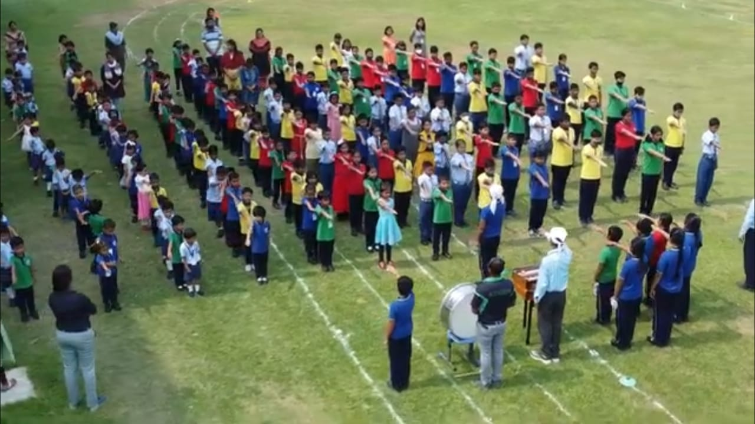
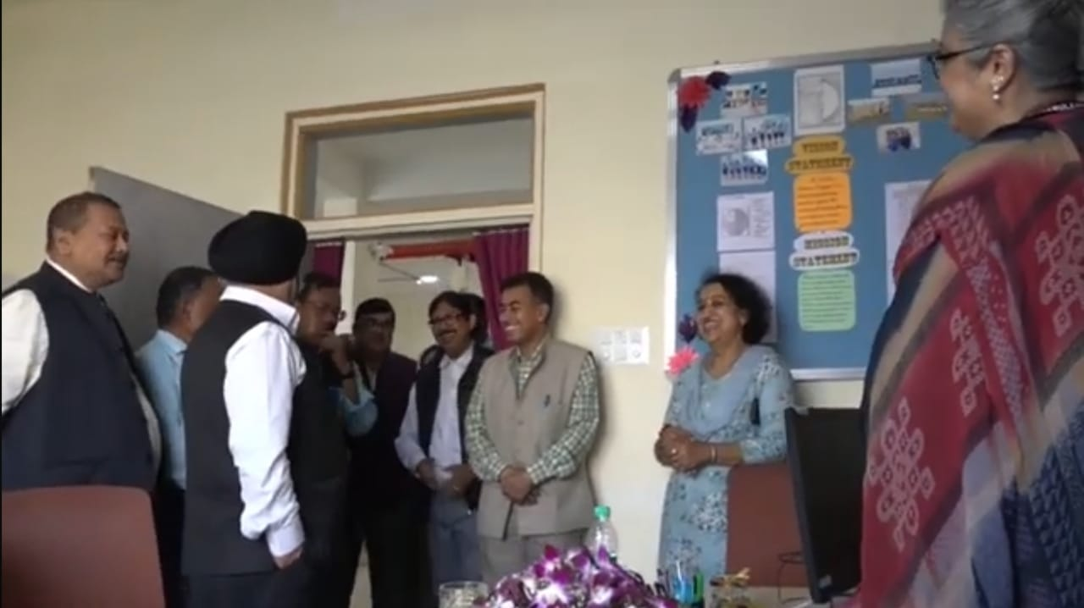
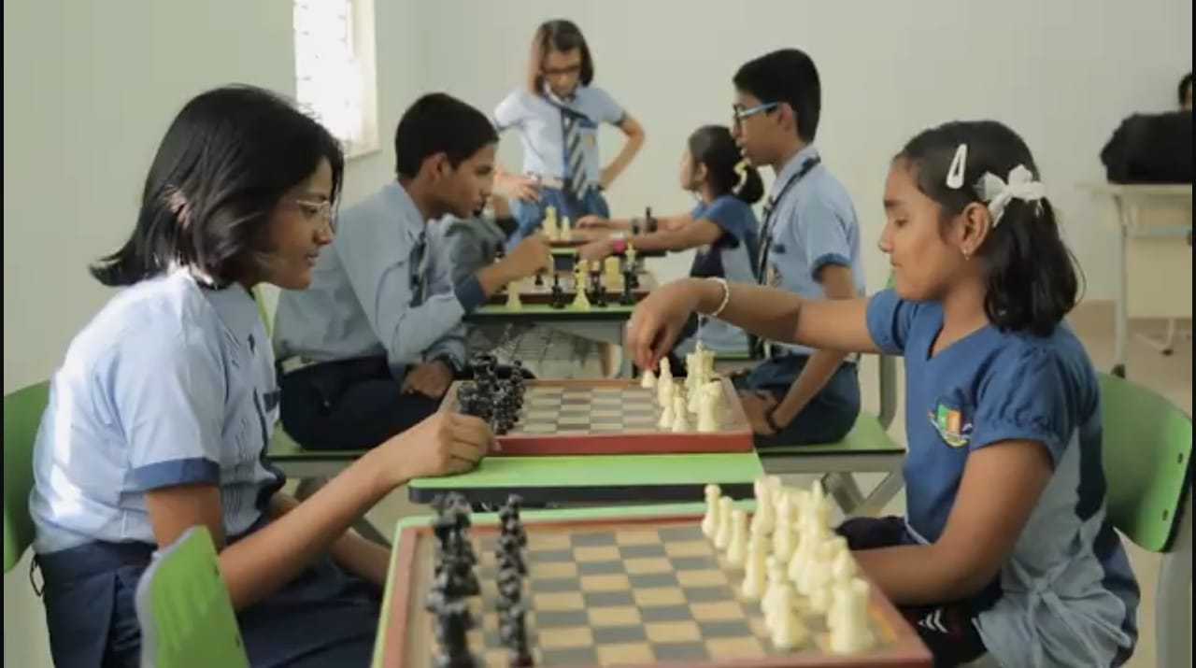
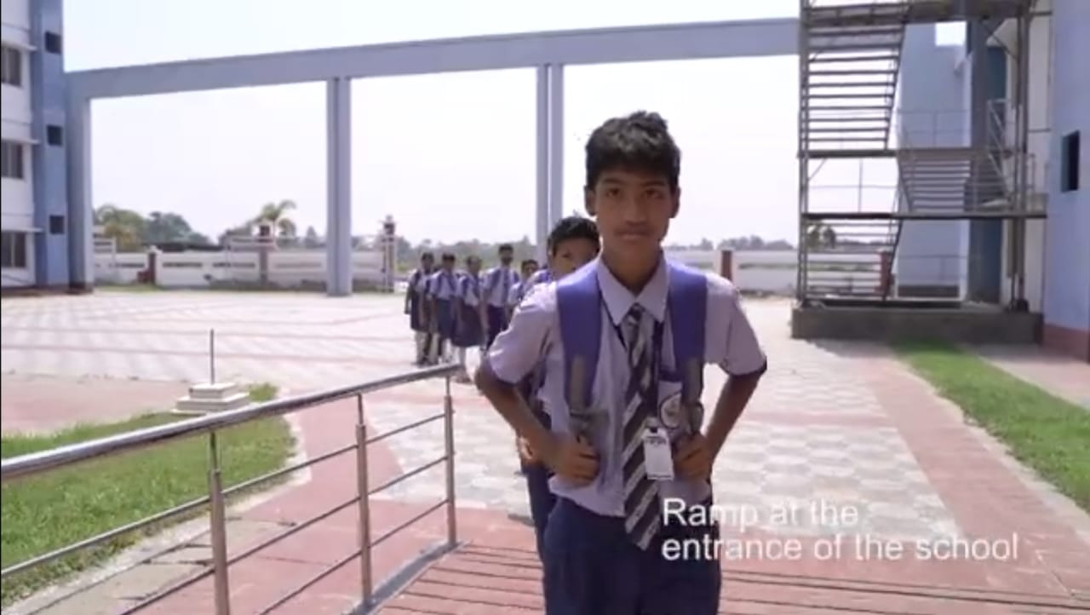

Slide 5
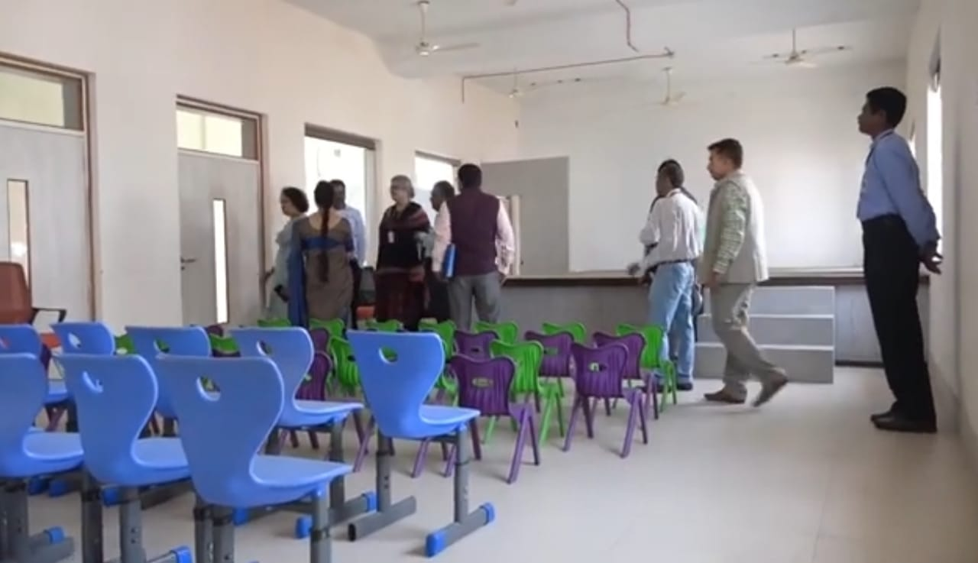
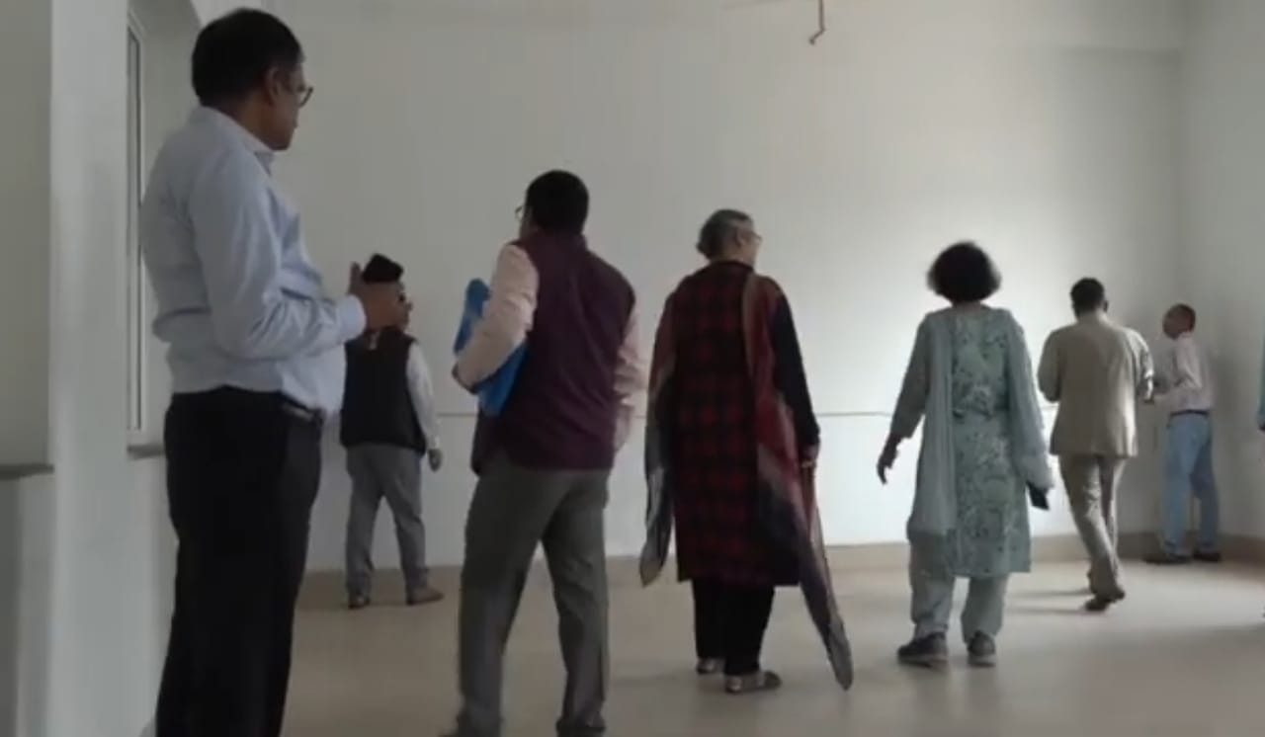
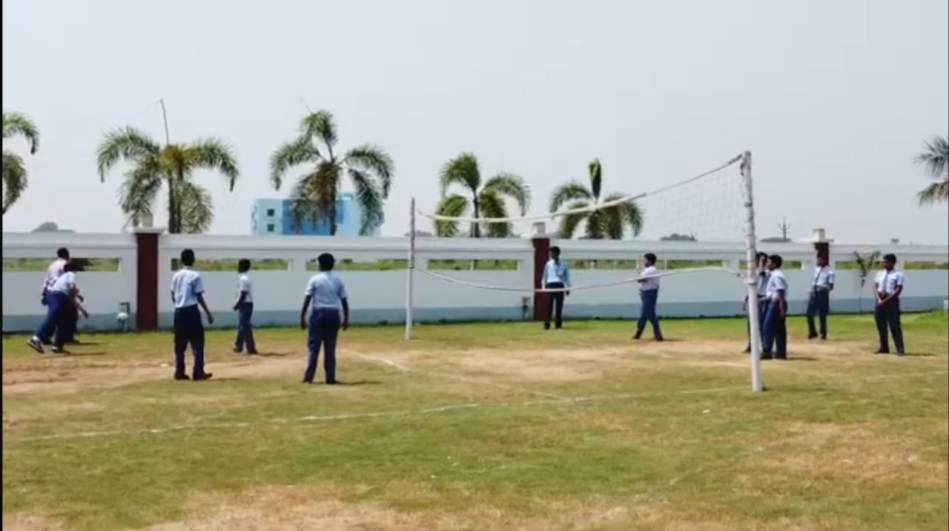

Slide 6
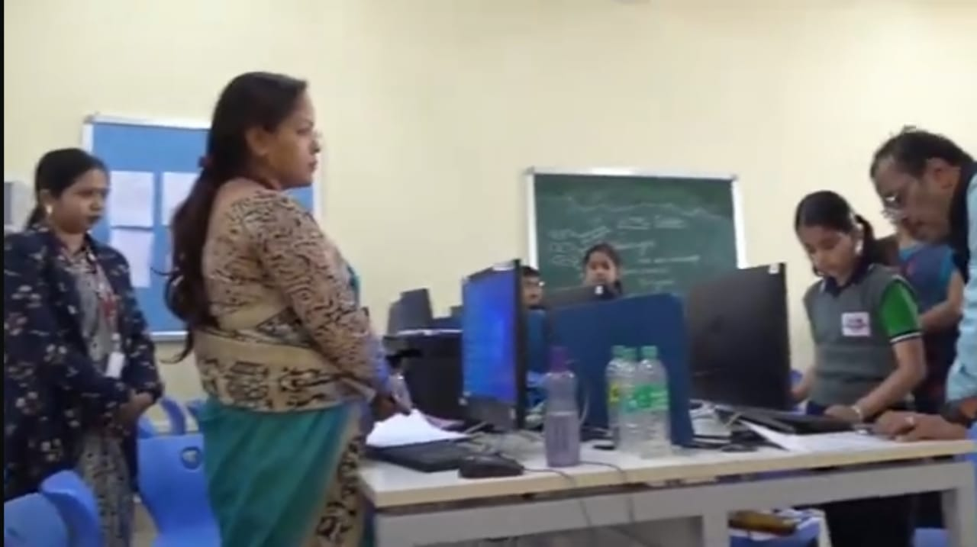
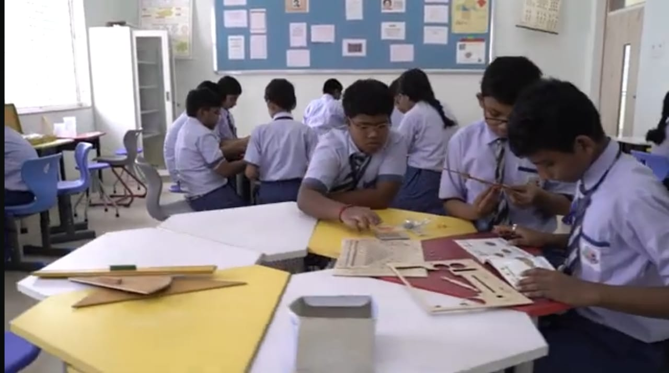
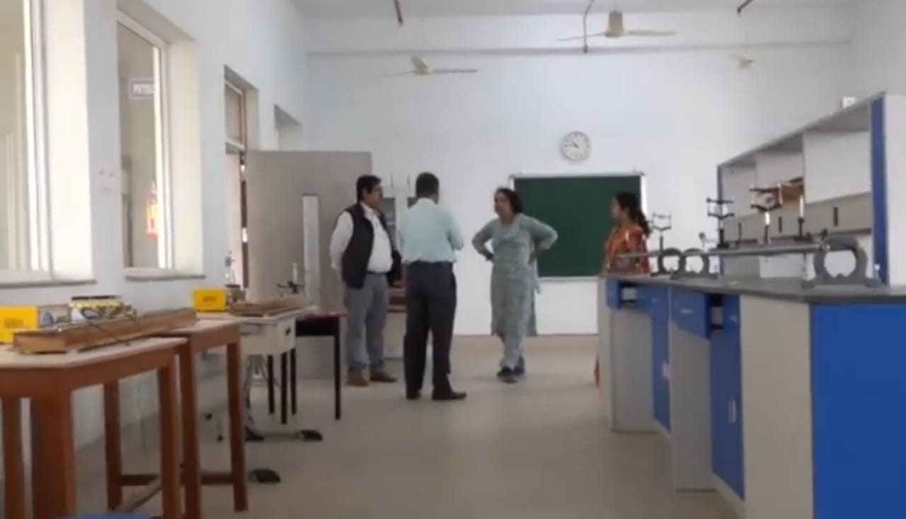
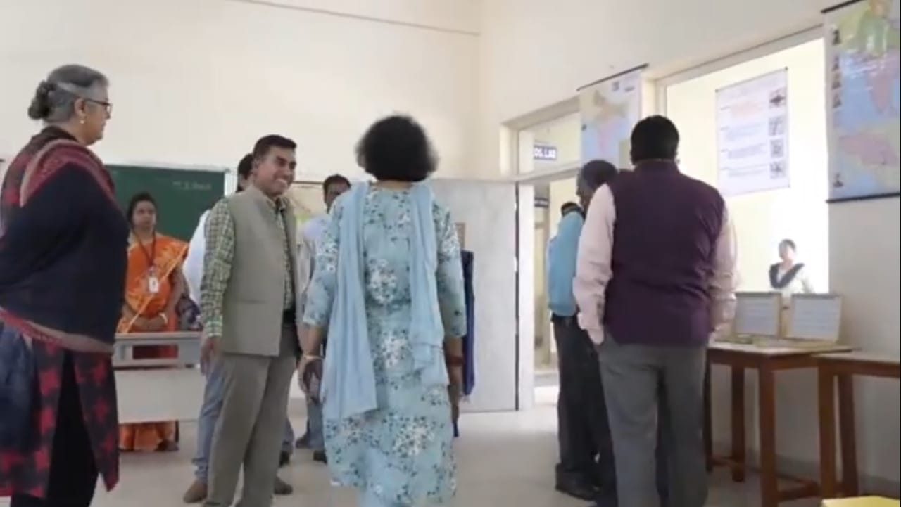
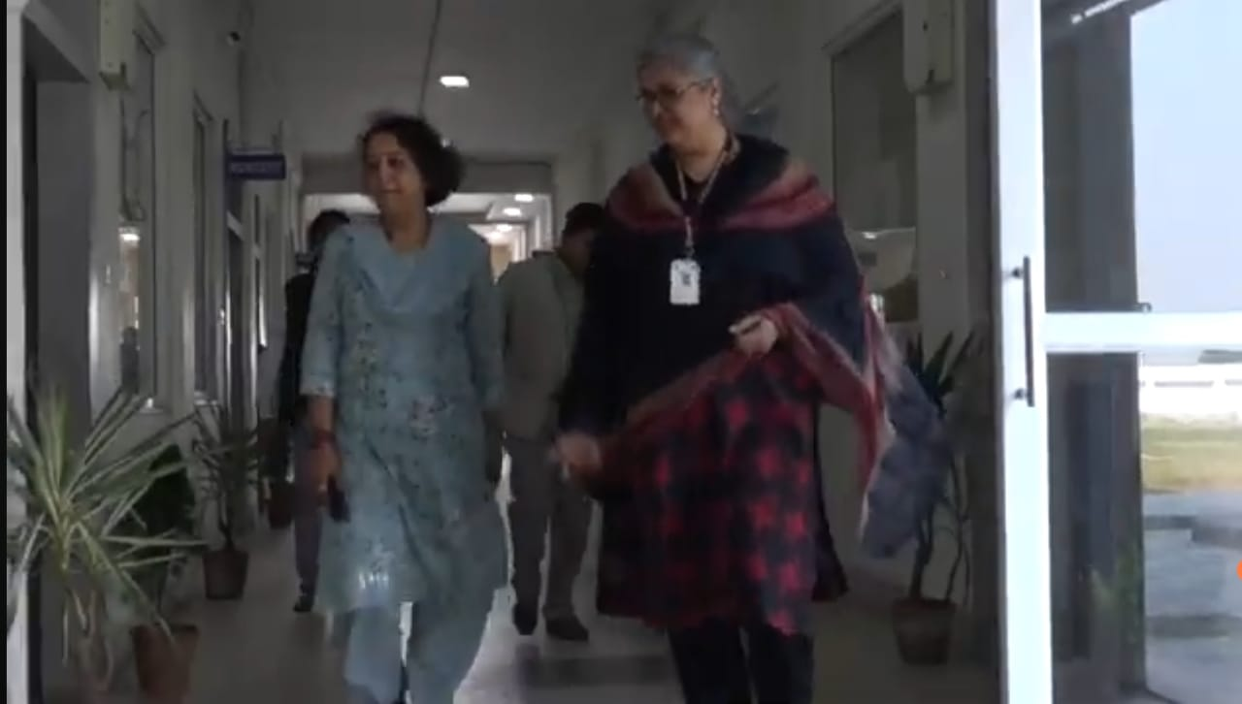

Slide 7
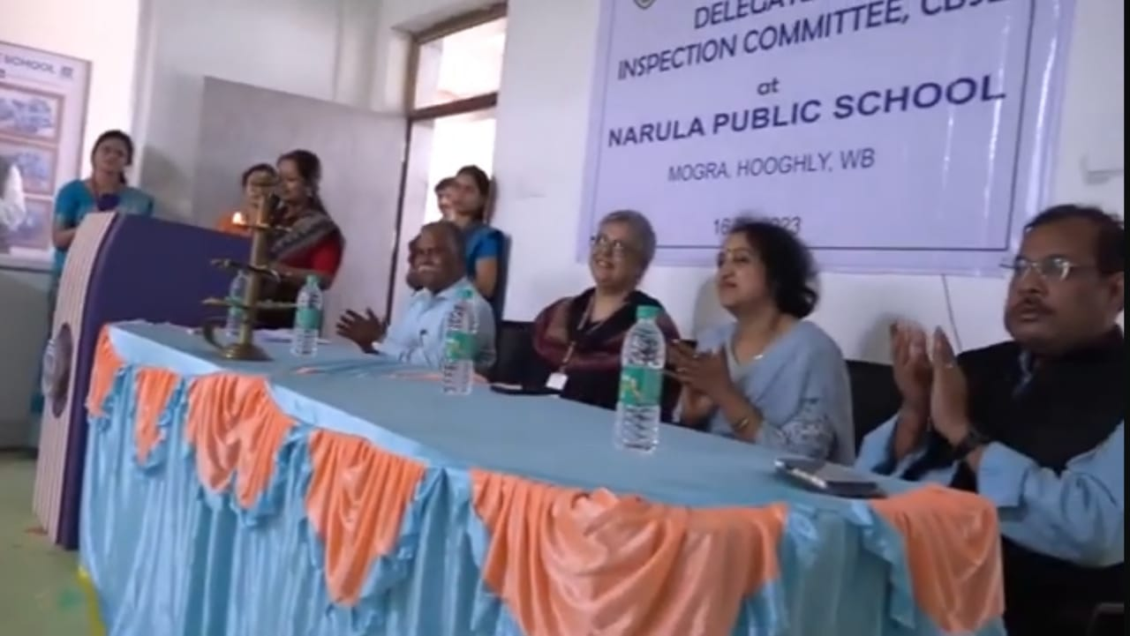

Slide 8
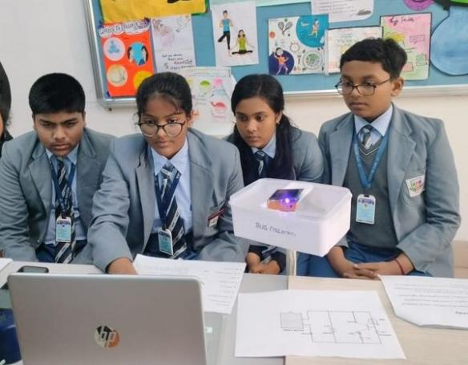
ACHIEVEMENT OF NPS STUDENTS AT THE NATIONAL LEVEL

Slide 9
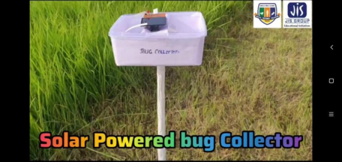

SCHOOL INNOVATION COUNCIL
UNDER THE ABLE GUIDANCE OF THE TEACHERS OF NARULA PUBLIC SCHOOL, STUDENTS HAVE PARTICIPATED IN THE CONTEST ORGANIZED BY THE SCHOOL INNOVATION COUNCIL, MINISTRY OF EDUCATION, IN COLLABORATION WITH AICTE WITH GREAT ZEA.THE STUDENTS HAVE PREPARED –A PROTOTYPE OF A SOLAR-POWERED BUG COLLECTORAND SOLAR-POWERED LCD NOTEBOOK.

Slide 10
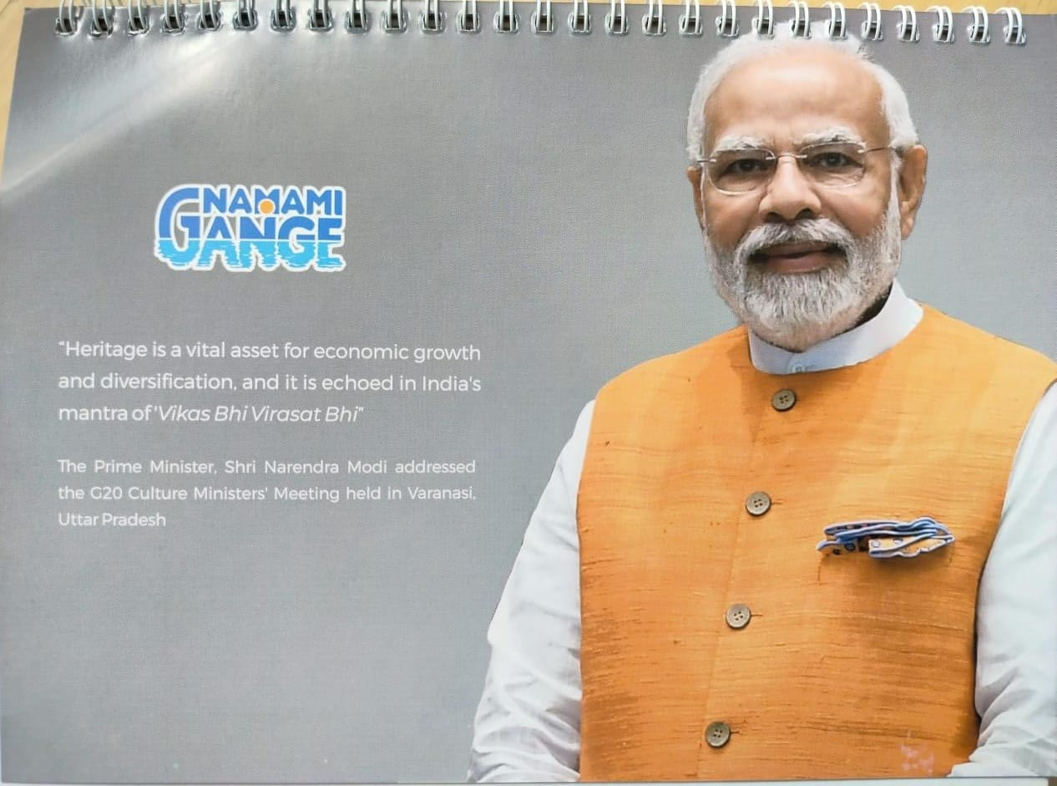
NAMAMI GANGE

Slide 11
Rick Das
IX

Slide 12
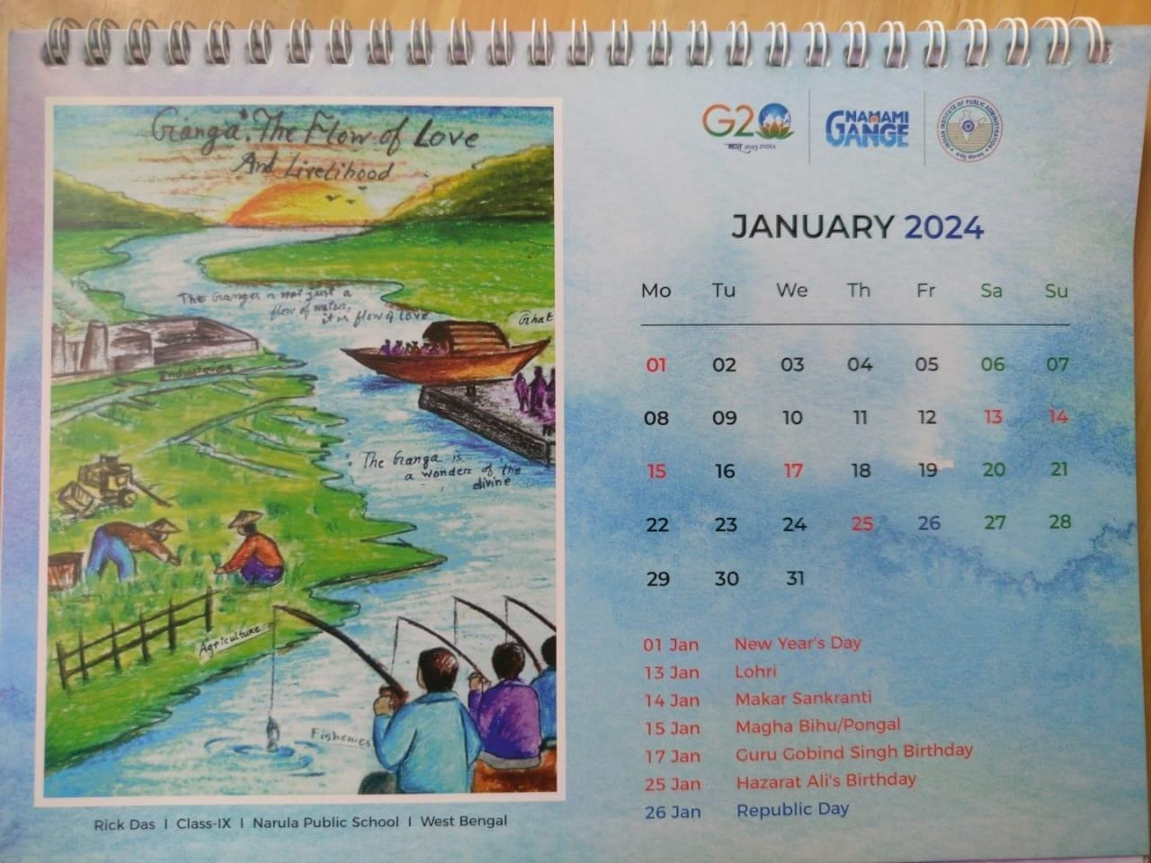

Slide 13
Abhirup Khan
IX

Slide 14
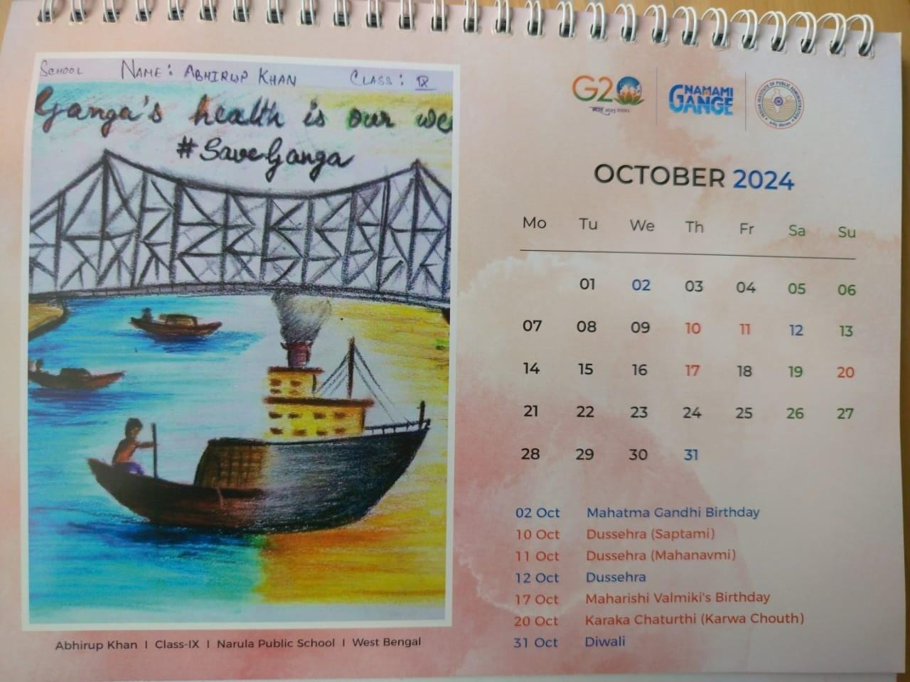

Slide 15
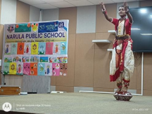
ACHIEVEMENTS OF NPS AT NATIONAL LEVEL
ARNABI DAS, A STUDENT OF GRADE- VII OF NARULA PUBLIC SCHOOL HAS BEENAWARDED A SCHOLARSHIP, A NATIONAL AWARD OF EXCELLENCE UNDER THE ‘CULTURAL TALENT SEARCHSCHOLARSHIP SCHEME’, IN THE FIELD OF GAUDIYA NRITYA.

Slide 16
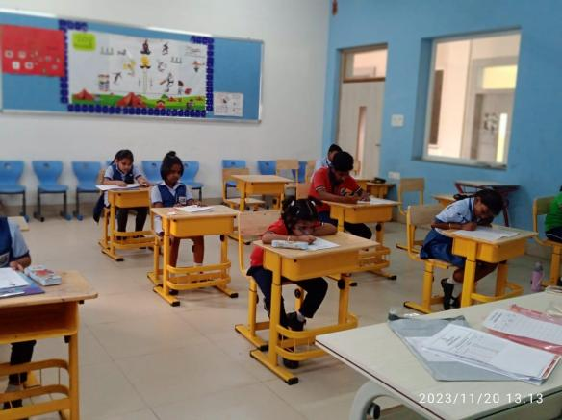
ACHIEVEMENT OF NPS STUDENTS AT THE INTERNATIONAL LEVEL (SOF).

Slide 17
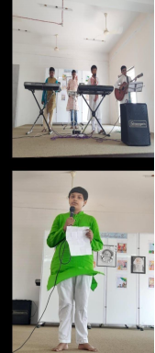
ANNUAL ACTIVITY CALENDAR OF NARULA PUBLIC SCHOOL, MOGRA; SESSION 2023-24 .
DATE | NAME OF THE EVENT | TYPE OF ACTIVITY | BRIEF REPORT | PHOTOS
15.04.2023 | POILA BAISHAKH (BENGALI NEW YEAR) | CO-CURRICULAR ACTIVITY | ON THE AUSPICIOUS OCCASION OF POILA BAISAKH, STUDENTS OF NARULA PUBLIC SCHOOL USED DIFFERENT HUES OF COLOURS TO DISPLAY ARTWORK, SYNCHRONISING THE BEAUTY OF THE FESTIVAL WITH THAT OF MOTHER NATURE.

Slide 18
POILA BAISHAKH
(BENGALI NEW YEAR)
ON THE AUSPICIOUS OCCASION OF POILA BAISAKH, STUDENTS OF NARULA PUBLIC SCHOOL USED DIFFERENT HUES OF COLOURS TO DISPLAY ARTWORK, SYNCHRONISING THE BEAUTY OF THE FESTIVAL WITH THAT OF MOTHER NATURE.

Slide 19
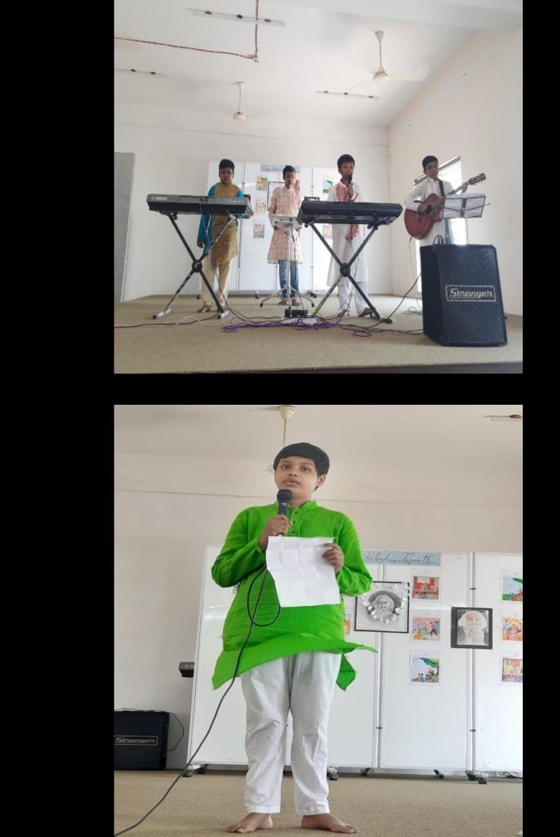
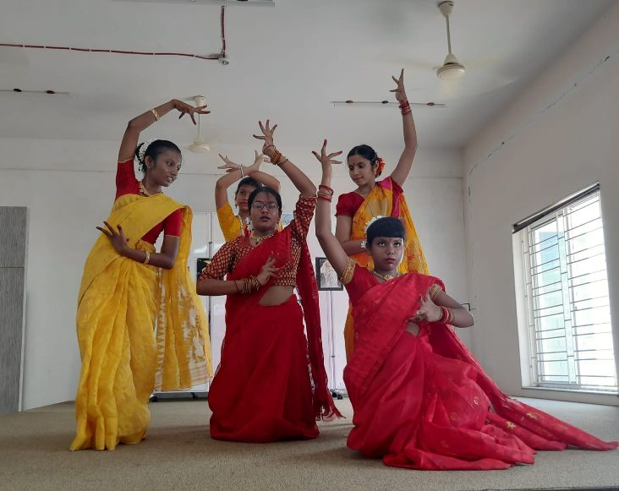

Slide 20
FUN ACTIVITY OF KINDERGARTEN STUDENTS .

Slide 21
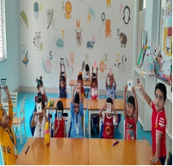
FUN ACTIVITY
A FUN ACTIVITY WAS ORGANIZED LAST WEEK FOR THE STUDENTS OF LOWER KINDERGARTEN, WHERE THEY IDENTIFIED THEIR NEW FRIENDS BY MAKING FRAMES USING ICE-CREAM STICKS, AND POSTER COLOURS, PASTING PICTURES ON PAPER AND SHOWING THE SAME TO EACH OTHER TO FOSTER FRIENDSHIP AND CAMARADERIE.

Slide 22
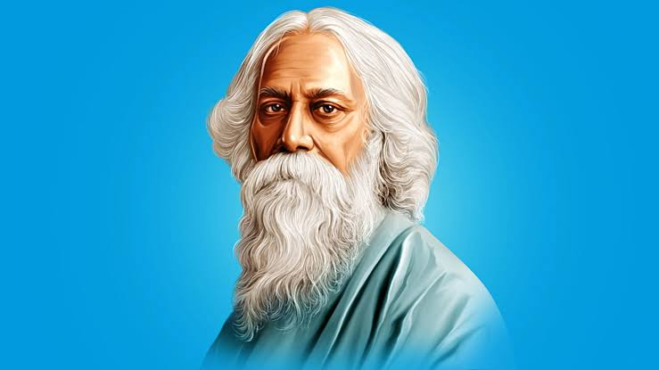
CELEBRATION OF RABINDRA JAYANTI

Slide 23
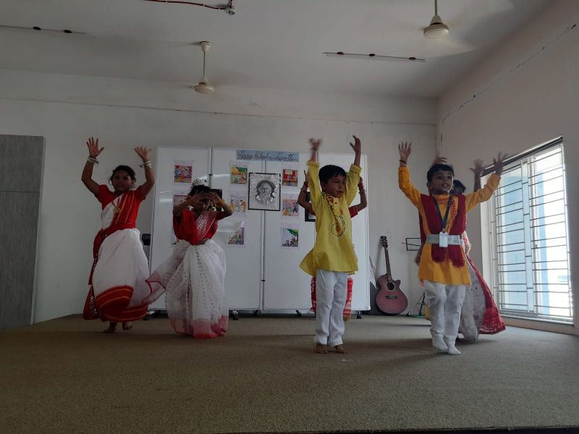
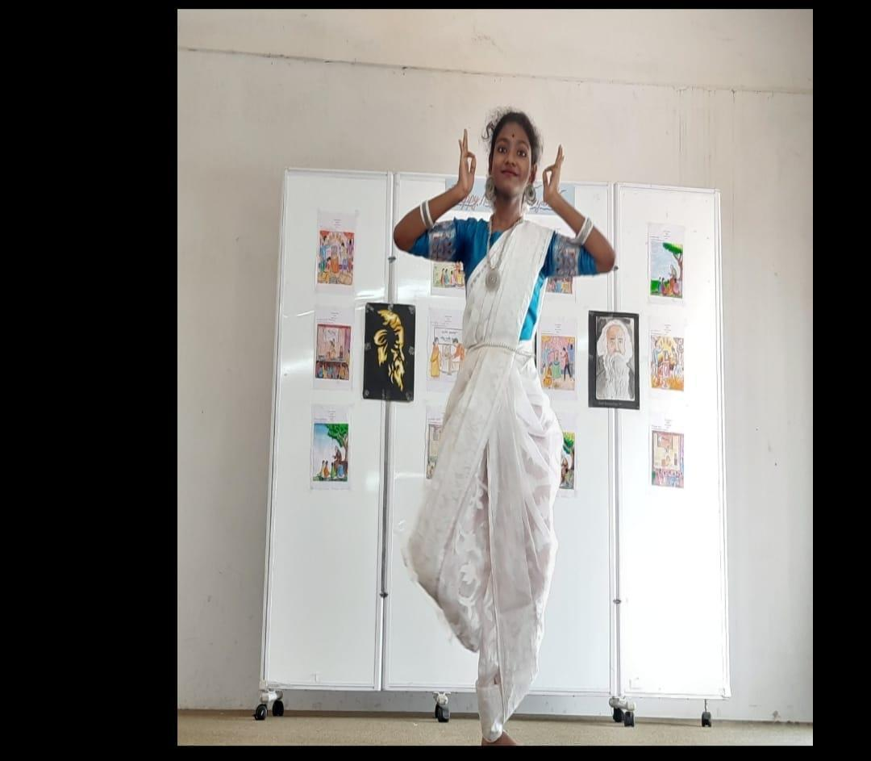
TO MARK THE BIRTH ANNIVERSARY OF KOBIGURU RABINDRANATH TAGORE, THE GREAT PHILOSOPHER, PATRIOT, SOCIAL REFORMER AND NOBEL LAUREATE, THE STUDENTS OF NARULA PUBLIC SCHOOL PAID A RICH TRIBUTE TO HIM AND REMEMBERED HIM THROUGH POETRY RECITATION, SINGING, DANCING AND A BRILLIANT PERFORMANCE BY THE SCHOOL BAND.
THE SCHOOL PRINCIPAL ENLIGHTENED ALL ABOUT TAGORE’S LITERARY AND PATRIOTIC IDEALS AND HAILED HIS COURAGE FOR RENOUNCING KNIGHTHOOD TO PROTEST AGAINST THE JALLIANWALLA BAGH MASSACRE.

Slide 24
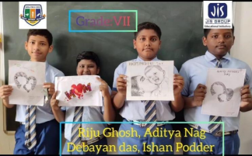
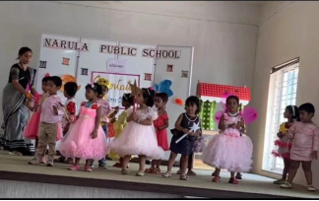
CELEBRATION OF MOTHER’S DAY
ORIENTATION PROGRAMME FOR TODDLERS

Slide 25
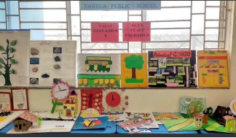
EXHIBITION ON TEXTUAL TOPIC

Slide 26
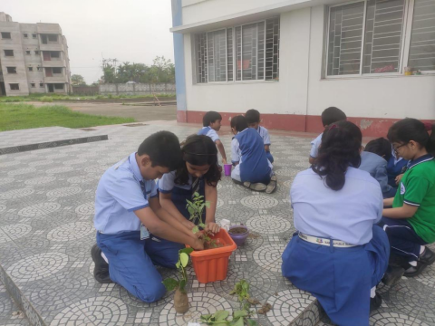
WORLD ENVIRONMENT DAY

Slide 27
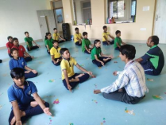
CELEBRATION OF INTERNATIONAL YOGA DAY

Slide 28
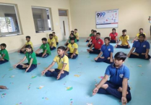
G20:C20 999 CHALLENGE

Slide 29
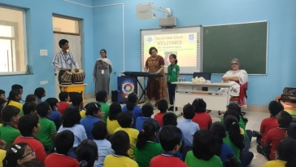
MUSIC THERAPY SESSION
THE STUDENTS OF NARULA PUBLIC SCHOOL, MOGRA, EXPERIENCED AN ENTHRALLING MUSIC THERAPY SESSION CONDUCTED BY RENOWNED PIANIST, PHILANTHROPIST AND SOCIAL ACTIVIST, MS. RAJLAKSHMI SYAM, ON 18TH JULY, 2023, WHO INSPIRED THEM TO FOLLOW THEIR PASSION AND LIBERATED THEM FROM THE MONOTONY OF EVERY DAY ROUTINE.

Slide 30
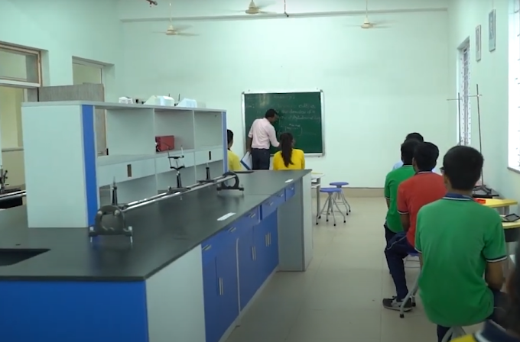
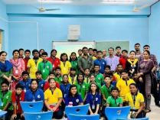
SEMINAR ON REDUCING CARBON FOOTPRINT BY TAPPING SOLAR ENERGY

Slide 31
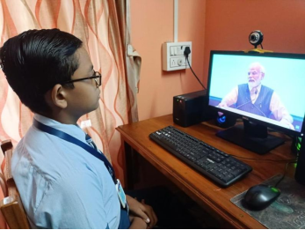
AKHIL BHARATIYA SHIKSHA SANGAM
THE STUDENTS, TEACHERS AND THE ADMINISTRATIVE FACULTY OF NARULA PUBLIC SCHOOL, MOGRA WITNESSED A WEBCAST ON A TWO-DAY EVENT “AKHIL BHARATIYA SHIKSHA SAMAGAM” ORGANIZED BY THE MINISTRY OF EDUCATION IN ASSOCIATION WITH THE MINISTRY OF SKILL DEVELOPMENT & ENTREPRENEURSHIP. THE EVENT COINCIDING WITH THE 3RD ANNIVERSARY OF NATIONAL EDUCATION POLICY 2020, HAS BEEN INAUGURATED BY THE HONOURABLE PRIME MINISTER SHRI NARENDRA MODI AT ITPO, PRAGATI MAIDAN, NEW DELHI. THE EVENT HAS ALSO BEEN GRACED BY THE PRESENCE OF UNION MINISTER FOR EDUCATION SHRI DHARMENDRA PRADHAN, MINISTERS OF STATE FOR EDUCATION, SECRETARIES OF DEPARTMENT OF SCHOOL EDUCATION AND LITERACY, DEPARTMENT OF HIGHER EDUCATION AND OTHER DELEGATES OF THE MINISTRY OF EDUCATION AND MINISTRY OF SKILL DEVELOPMENT AND ENTREPRENEURSHIP ALONG WITH HEADS OF AUTONOMOUS BODIES

Slide 32
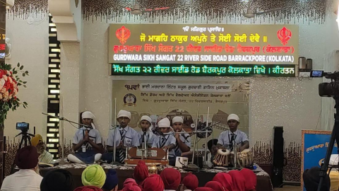
GURBANI GYAN COMPETITION

Slide 33
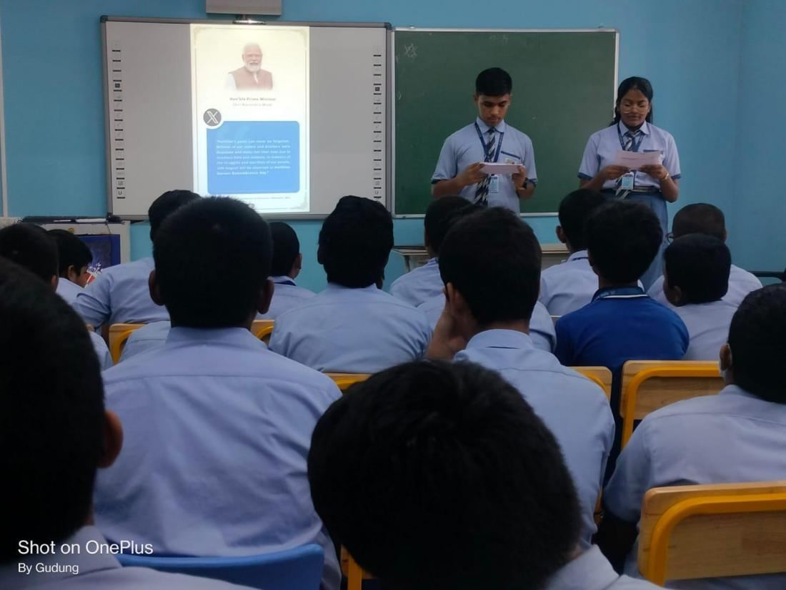
PARTITION HORRORREMEMBRANCE DAY

Slide 34
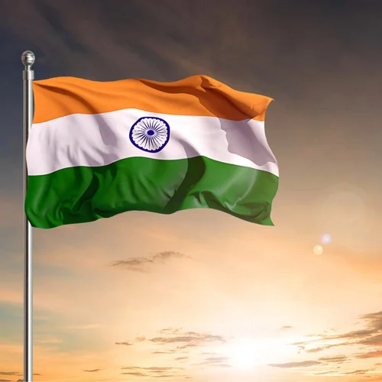
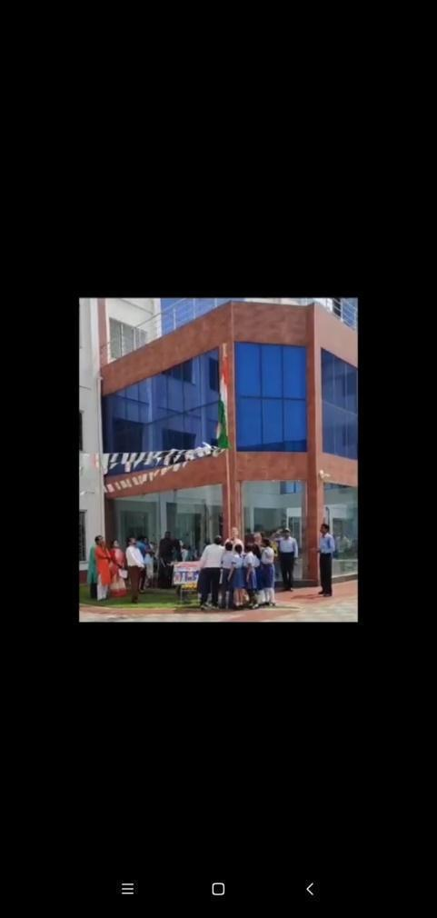
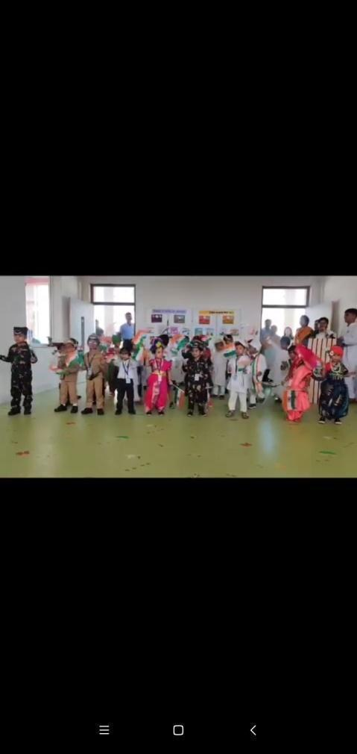
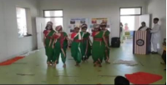
INDEPENDENCE DAY CELEBRATION

Slide 35
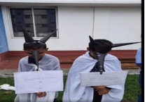
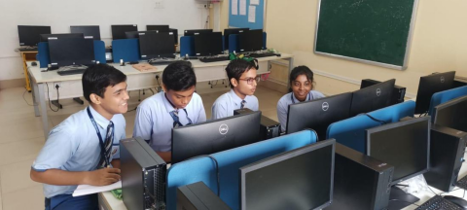
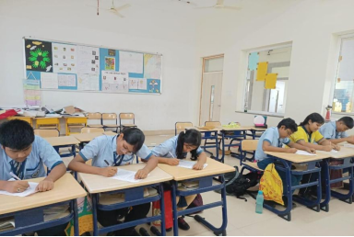
DENGUE PREVENTION DAY
WIZ QUIZ
SECOND CBSE EXPRESSION SERIES

Slide 36
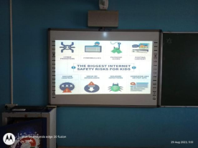
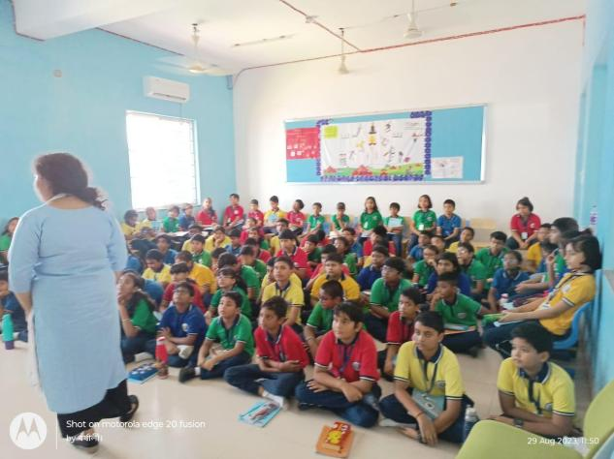
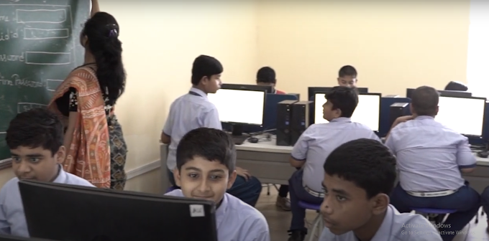
CYBER SAFETY INITIATIVE

Slide 37
GOVERNMENT INITIATIVE
NARULA PUBLIC SCHOOL, MOGRA HAD THE PRIVILEGE TO BE A PART OF A THREE-DAY “BLENDED CAPACITY PROGRAM FOR STAKEHOLDERS OF RIVER GANGA” PHASE - II, ORGANISED BY IIPA (INDIAN INSTITUTE OF PUBLIC ADMINISTRATION, NEW DELHI) UNDER THE NAMAMI GANGE INITIATIVE FROM 13TH-15TH SEPTEMBER,2023.STUDENTS FROM GRADE VI-IX & XI ALONG WITH TEACHERS PARTICIPATED IN THIS EVENT. THE WINNER OF THE POSTER MAKING COMPETITION ARE1ST: RICK DAS, GRADE IX2ND: ABHIRUP KHAN, GRADE IX3RD:ARCHISMITA DAS, GRADE VIII.

Slide 38

VEERGATHA 3.0 (CBSE INITIATIVE)
CBSE INITIATIVE
THE STUDENTS OF NARULA PUBLIC SCHOOL PARTICIPATED IN VEER GATHA EDITION 3.0 & 2ND CBSE EXPRESSION SERIES, TO EXPLORE THE CREATIVE FACULTIES OF THE STUDENTS. IN THESE EVENTS WITH GREAT ENTHUSIASM AND RECEIVED CERTIFICATES FROM THE PREMIER BOARD FOR THEIR EFFORTS

Slide 39

'QUIT TOBACCO' CAMPAIGN
THE STUDENTS OF NARULA PUBLIC SCHOOL MADE MEANINGFUL POSTERS TO SPREAD AWARENESS AMONG STAKEHOLDERS AGAINST THE NEGATIVE IMPACT OF TOBACCO USE TO ADDRESS HEALTH ISSUES ARISING DUE TO TOBACCO CONSUMPTION, CBSE DEDICATED THE 'QUIT TOBACCO' CAMPAIGN TO COMMEMORATE THE 154TH BIRTH ANNIVERSARY OF MAHATMA GANDHI ON OCTOBER 2ND THIS YEAR

Slide 40



CELEBRATION OF MENTAL HEALTH WEEK

Slide 41

NIT-LIT LITERARY FEST

Slide 42
THE STUDENTS OF GRADES VI-XI OF NARULA PUBLIC SCHOOL, MOGRA PARTICIPATED IN AN ENLIGHTENING AND CULTURALLY ENRICHING EVENT, NIT-LIT FEST 2023 HELD AT NARULA INSTITUTE OF TECHNOLOGY, AGARPARA, ON 12TH OCTOBER, 2023. THIS INTER-INSTITUTE LITERARY FEST AIMED TO NURTURE CREATIVE MINDS, FOSTER COMMUNICATION SKILLS AND CONTRIBUTE TO THE PERSONALITY DEVELOPMENT OF YOUNG LEARNERS.

Slide 43



SHARADIYA AGAMANI
AS DURGA PUJA IS CELEBRATED TO MARK THE VICTORY OF GODDESS DURGA OVER THE DEMON KING MAHISHASURA, THE STUDENTS OF NARULA PUBLIC SCHOOL CELEBRATED AGOMONI OF GODDESS DURGA TODAY WITH GREAT ENTHUSIASM AND REVELLED IN THE PERFORMANCES STAGED BY THEIR PEERS TO REMINISCE THE STRENGTH.

Slide 44


UNITY RUN ON RASHTRIYA EKTA DIWAS

Slide 45

DIWALI CELEBRATION

Slide 46

INVESTITURE CEREMONY

Slide 47

CELEBRATION OF THE CONSTITUTION DAY
THE STUDENTS OF NARULA PUBLIC SCHOOL, MOGRA PARTICIPATED IN A NUMBER OF ACTIVITIES TO CELEBRATE ‘CONSTITUTION DAY’ FOR HIGHLIGHTING AND REITERATING THE VALUES AND PRINCIPLES ENSHRINED IN THE CONSTITUTION.

Slide 48

CBSE EXPRESSION SERIES 3.0
THE STUDENTS OF NARULA PUBLIC SCHOOL PARTICIPATED IN THE 3RD EXPRESSION SERIES FOR THE ACADEMIC SESSION 2023-24, ORGANIZED BY CBSE ON THE THEME ‘DISASTER RISK RESILIENCE & REDUCTION: ROLE OF CITIZEN. THE STUDENTS WERE SEGREGATED INTO THREE CLASS CATEGORIES AND EACH CATEGORY WAS ASSIGNED SEPARATE TOPICS TO PORTRAY THEIR IMAGINATIONS BY VARIOUS MEDIUMS, NAMELY, WRITING AN ESSAY, PAINTING OR WRITING A POEM.

Slide 49



CELEBRATION OF BHARATIYA BHASA UTSAV
STUDENTS OF NARULA PUBLIC SCHOOL PARTICIPATED IN MUSIC, DANCE, RECITATION, AND OTHER ARTISTIC PERFORMANCES IN ACCORDANCE WITH THE MOE, GOVT. OF INDIA'S DECISION TO CELEBRATE THE BIRTH ANNIVERSARY OF MAHAKAVI SUBRAMANIA BHARATI AS BHARATIYA BHASHA USTAV
SPECIAL SCREENING OF A MOVIE

Slide 50

CELEBRATION OF CHRISTMAS EVE AND WINTER CARNIVAL

Slide 51

CBSE SAHODAYA SPORTS MEET
STUDENTS OF NPS HAVE PARTICIPATED ON CBSE SAHODAYA SCHOOL COMPLEX SPORTS MEET AT ASIAN INTERNATIONAL SCHOOL.

Slide 52




Slide 53

JIS INTERSCHOOL SPORTS MEET
THE STUDENTS OF NARULA PUBLIC SCHOOL PARTICIPATED IN THE 1ST JIS INTER-SCHOOL’S ATHLETICS MEET TODAY AT THE GITANJALI STADIUM, KOLKATA ORGANISED BY JIS GROUP.

Slide 54

PARIKSHA PE CHARCHA
THE STUDENTS OF GRADES VI-IX AND XI AND THE TEACHING FACULTY OF NARULA PUBLIC SCHOOL, MOGRA, PARTICIPATED IN THE LIVE SESSION OF PARIKSHA PE CHARCHA, 2024, ORGANIZED BY THE MINISTRY OF EDUCATION AND BROADCASTED ON DOORDARSHAN, WHICH IS A PART OF THE LARGER PATHBREAKING MOVEMENT- ‘EXAM WARRIORS’ LED BY PRIME MINISTER NARENDRA MODI TO ENSURE A STRESS-FREE ATMOSPHERE FOR YOUNGSTERS.

Slide 55

REPUBLIC DAY CELEBRATION

Slide 56


Slide 57
JIS SAMMAN AWARD
JIS SAMMAN 2024, THE BIGGEST AWARD CEREMONY HOSTED BY THE JIS GROUP, TOOK PLACE ON FEBRUARY 1, 2024, AT THE BISWA BANGLA CONVENTION CENTRE.THE EVENT WAS GRACED BY DISTINGUISHED GUESTS, CELEBRITIES, SCHOLARS, PROMINENT FIGURES FROM THE CULTURAL AND SPORTS ARENAS, AND MEMBERS OF THE JIS GROUP COMMUNITY, THE STUDENTS OF NPS HAVE BEEN AWARDED FOR THEIR EXTRAORDINARY PERFORMANCES IN THE ANNUAL INTER-SCHOOL SPORTS MEET.

Slide 58



CELEBRATION OF SARASWATI PUJA

Slide 59

MOTIVATIONAL TALK BY DR. GOURAB DAS
“CREATIVE MINDS LEAD TO EVOLUTION OF GREAT SCIENCES”.
INVENTIONS AND DISCOVERIES HAVE EMANATED FROM CREATIVE MINDS CONSTANTLY WORKING AND IMAGINING THE OUTCOME IN THE MIND. WITH IMAGING AND CONSTANT EFFORT, ALL THE FORCES OF THE UNIVERSE WORK FOR THAT INSPIRED MIND, THEREBY LEADING TO INVENTIONS OR DISCOVERIES.”

Slide 60

HANDS-ON WORKSHOP ON FLN

